Slide 1
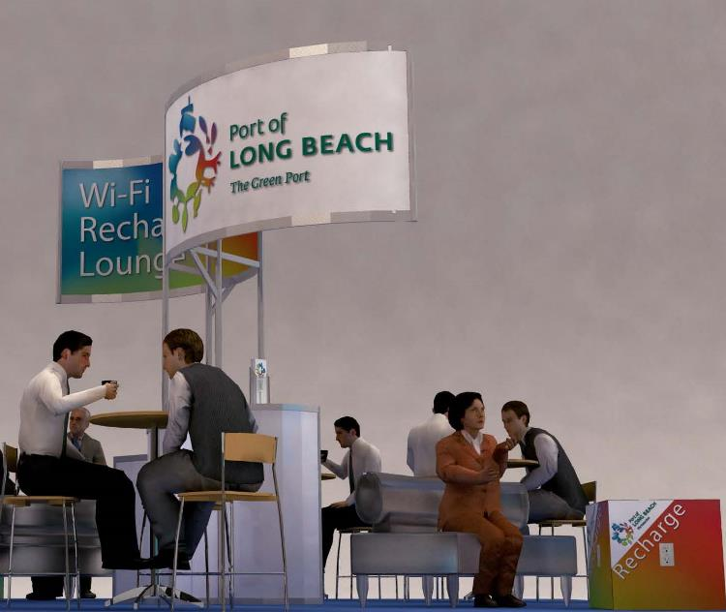
Port of Long Beach
Trade Show WiFi & Recharge Lounge
Miscellaneous

